Slide 1
Update: Piezo-energy harvesting
Chongan Wang
2025-01-17

Slide 2
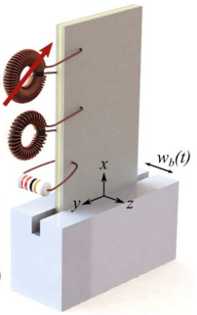
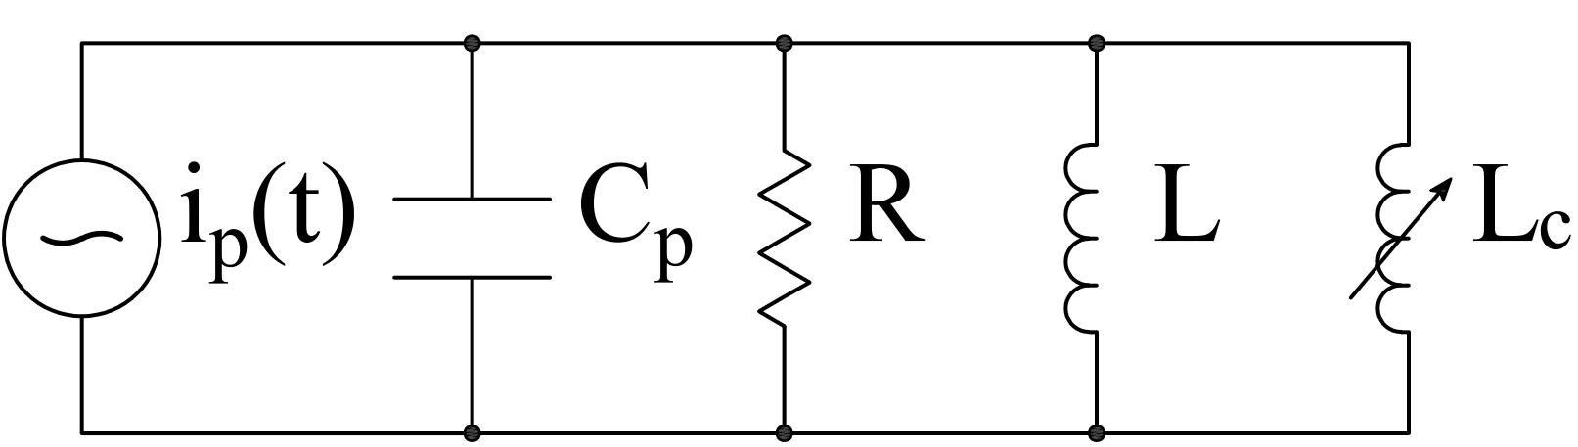

Previous problem
$$v\left(t\right)$$
Last time we found out that the ROM results do not agree with the full simulation

Slide 3


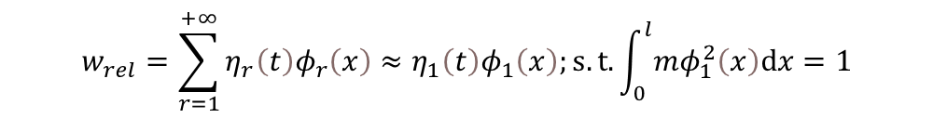
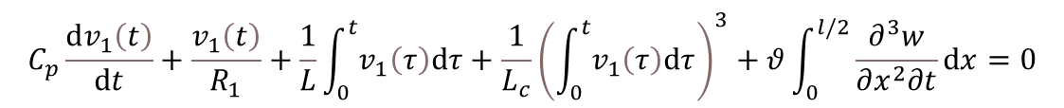
ROM Ansatz
$$−\frac{∂^{2}M}{∂x^{2}}+m\frac{∂^{2}w}{∂t^{2}}=0$$
Full model:
$$M=−YI\frac{∂^{2}w}{∂x^{2}}+θv_{1}\left(t\right)\left[H\left(x\right)−H\left(x−\frac{l}{2}\right)\right]+θv_{2}\left(t\right)\left[H\left(x−\frac{l}{2}\right)−H\left(x−l\right)\right]$$
$$C_{p}\frac{dv_{1}\left(t\right)}{dt}+\frac{v_{1}\left(t\right)}{R_{1}}+\frac{1}{L}\int_{0}^{t}{v_{1}\left(τ\right)dτ}+\frac{1}{L_{c}}{\left(\int_{0}^{t}{v_{1}\left(τ\right)dτ}\right)}^{3}+θ\int_{0}^{l/2}{\frac{∂^{3}w}{∂x^{2}∂t}dx}=0$$
$$w_{rel}=\sum_{r=1}^{+∞}{η_{r}\left(t\right)φ_{r}\left(x\right)}≈η_{1}\left(t\right)φ_{1}\left(x\right);s.t.\int_{0}^{l}{mφ_{1}^{2}\left(x\right)dx}=1$$
Ansatz:
$${\ddot{η}}_{1}\left(t\right)+ω_{1}^{2}η_{1}−χ_{1,1}{\dot{λ}}_{1}=χ_{1,2}v_{2}+f\left(t\right)$$
$$C_{p}{\ddot{λ}}_{1}+\frac{1}{R_{1}}{\dot{λ}}_{1}+\frac{1}{L}λ_{1}+\frac{1}{L_{c}}λ_{1}^{3}+χ_{1,1}{\dot{η}}_{1}=0$$
ROM:
Approach: Focus on the linear regime and check the ansatz

Slide 4





Frequency comparison
Compute the frequency for zero modulator voltage and base displacement
$$v\left(t\right)$$
$$−\frac{∂^{2}M}{∂x^{2}}+m\frac{∂^{2}w}{∂t^{2}}=0$$
Full model:
$$M=−YI\frac{∂^{2}w}{∂x^{2}}+θv_{1}\left(t\right)\left[H\left(x\right)−H\left(x−\frac{l}{2}\right)\right]$$
$$ω_{ext}=500rad/s$$
$$C_{p}\frac{dv_{1}\left(t\right)}{dt}+\frac{1}{L}\int_{0}^{t}{v_{1}\left(τ\right)dτ}+θ\int_{0}^{l/2}{\frac{∂^{3}w}{∂x^{2}∂t}dx}=0$$
FEM results (40 elements): $ω_{1}=475.4rad/s$
Assume that the beam vibrate in its first mode
$${\ddot{η}}_{1}\left(t\right)+ω_{1}^{2}η_{1}−χ_{1,1}{\dot{λ}}_{1}=χ_{1,2}v_{2}+f\left(t\right)=0$$
$$C_{p}{\ddot{λ}}_{1}+\frac{1}{L}λ_{1}+χ_{1,1}{\dot{η}}_{1}=0$$
ROM:
The error of linear estimation may lead to incorrect critical amplitude of nonlinear solutions
ROM results: $ω_{1}=477.3rad/s$

Slide 5

Frequency comparison
Compute the frequency for zero modulator voltage and base displacement
$$v\left(t\right)$$
$$ω_{ext}=500rad/s$$
A torque resulting from the piezoelectric patches
The error of linear estimation may lead to incorrect critical amplitude of nonlinear solutions

Slide 6
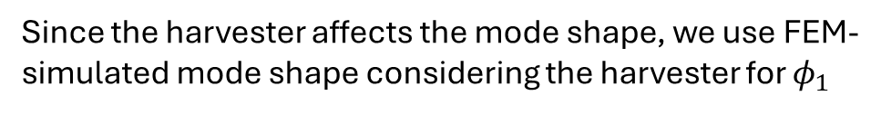
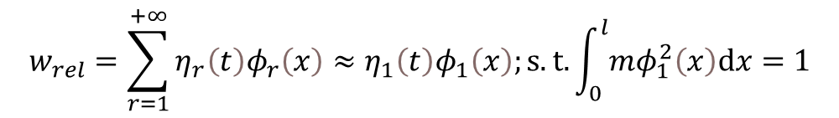

Modification
$$w=w_{b}\left(t\right)+w_{rel}\left(x,t\right)$$
$$v\left(t\right)$$
Ansatz:
Base excitation
Relative displacement
$$w_{rel}=\sum_{r=1}^{+∞}{η_{r}\left(t\right)φ_{r}\left(x\right)}≈η_{1}\left(t\right)φ_{1}\left(x\right);s.t.\int_{0}^{l}{mφ_{1}^{2}\left(x\right)dx}=1$$
$$ω_{ext}=500rad/s$$
Since the harvester affects the mode shape, we use FEM-simulated mode shape considering the harvester for $φ_{1}$
$${\ddot{η}}_{1}\left(t\right)+ω_{1}^{2}η_{1}−χ_{1,1}{\dot{λ}}_{1}=χ_{1,2}v_{2}+f\left(t\right)$$
$$C_{p}{\ddot{λ}}_{1}+\frac{1}{R_{1}}{\dot{λ}}_{1}+\frac{1}{L}λ_{1}+\frac{1}{L_{c}}λ_{1}^{3}+χ_{1,1}{\dot{η}}_{1}=0$$
ROM:
where, $f\left(t\right)=−m\frac{d^{2}w_{b}}{dt}\int_{0}^{l}{φ_{1}\left(x\right)dx}$, $χ_{1,1}=θφ_{1}^{′}\left(\frac{l}{2}\right)$, $χ_{1,2}=θ\left(φ_{1}^{′}\left(l\right)−φ_{1}^{′}\left(\frac{l}{2}\right)\right)$, $ω_{1}$ denotes the natural frequency of the first mode are updated accordingly

Slide 7



Updated Results
$$v\left(t\right)$$
$$ω_{ext}=500rad/s$$
We consider the case $L_{c}=0.022$, where previous ROM does not match the FEM results

Slide 8

Updated Results
$$v\left(t\right)$$
$$ω_{ext}=500rad/s$$
We consider the case $L_{c}=0.017$, where we hit the high-branch with stronger nonlinearity

Slide 9
Concluding Remark
We show that the ansatz in the previous ROM is the reason for the disparity between ROM and full beam simulation
Specifically, previous ROM assumes that the beam is vibrating at its first bending mode, which leads to the error
We found one way to improve the ROM. We can still use one DOF for the beam, but the beam-deflection takes the mode shape considering the piezoelectric patch.
The updated ROM still cannot perfectly match the FEM simulations. However, the accuracy has been much improved.

